Slide 1

CipherShield: Pioneering Multi-Key Cryptographic approach for Dynamic File Encryption
A Comprehensive Approach to Protecting Digital Content
Mohammed Abdul Lateef
M. Tech - CFIS - II Yr
22011DA802
JNTUH
Dissertation Project Review
Under the guidance of:
Dr. P. Swetha
Professor of Computer Science
Deputy Director, Directorate of Academic Affairs
JNTUH

Slide 2
Agenda:
Introduction
Current System
Literature Review
Objectives
Use Cases
Proposed system
List of System Modules
Cryptographic Implementation
System Architecture
Performance Evaluation
Conclusion

Slide 3
The incessant threats of data theft pose significant risks to creators, industries, and the integrity of digital content.
In response to this imperative, our attempt presents a groundbreaking approach to file encryption, tailored to the unique characteristics of end users
1. Introduction:
Dynamic system to handle Cryptographic File Encryption

Slide 4
2. Current Challenges in Fortifying Digital Assets
Dynamic system can adaptively generate and manage keys.
System enables the use of a hybrid approach, such as combining RSA with ECC and AES
Adaptability and responsiveness, allowing for a robust defense against contemporary cryptographic threats

Slide 5
The cryptographic solution proposed aims to elevate the data security by implementing a system that uses the encryption models as per the file types.
3. Literature Review
A Novel Hybrid Multikey Cryptography Technique for Video Communication
Yousef Fouzar and et. al. , ‘‘A Novel Hybrid Multikey Cryptography Technique for Video Communication’’ IEEE Access, vol. 11, Jan. 2023.
Each encryption iteration for next chunk of video data adds an additional layer of security, contributing to enhanced data protection.

Slide 6

4. Objectives: Implementing a Dynamic Software System for Real-Time Encryption
Develop a comprehensive file encryption approach.
Tailor cryptographic strategies for text and video content.
Realize a dynamic software system with dedicated modules.

Slide 7
The cryptographic solution proposed aims to elevate the data security by implementing a system that uses the encryption models as per the file types.
5. Use Case
A multinational corporation regularly conducts sensitive board meetings and strategy sessions via video conferencing. Given the confidential nature of these discussions, ensuring the security and privacy of the video stream is paramount
Implementation:
Encryption:
Video stream divided into encrypted chunks using a hybrid of RSA and other cryptographic algorithms.
Dynamic encryption keys generated for each chunk, enhancing security.
Transmission:
Encrypted video chunks securely transmitted to all participants.
Even if intercepted, content remains unreadable.
Decryption:
Participants' devices decrypt chunks in real-time using appropriate keys.
Only authorized participants access decrypted video content.

Slide 8
The cryptographic solution proposed aims to elevate the data security by implementing a system that uses the encryption models as per the file types.
6. Proposed Solution and Highlights
The cryptographic solution proposed aims to elevate the data security by implementing a system that uses the encryption models as per the file types.
File types focused: - Text and Video
Adaptive Encryption based on Content Characteristics: Adaptive approach for text and video content.
Dynamic Key Generation: Enhanced Real-time key generation for evolving data (based on streamed encrypted chunks).
Dedicated Software Modules: Tailored solutions for text and video encryption/decryption.

Slide 9
The cryptographic solution proposed aims to elevate the data security by implementing a system that uses the encryption models as per the file types.
7. Modules from proposed system
Following are the initial list of modules crafted for proposed system
User Interface Module
Unique attribute storage
Key param initialization
Key Management
File Chunking
Encryption
Secure Communication Module - streaming
File Concatenation
Decryption

Slide 10
8. Cryptographic Implementation
1. Text Encryption:
AES based encryption where key is encrypted with RSA
2. Video Encryption:
AES Key Derived from ECC Equation, Encrypted with RSA Hybrid Encryption

Slide 11
8.1
Approach for Text based input
1 . Message
2. AES encryption – N - times
3AES based Cipher & AES key
4. RSA based encryption for aes key
5. RSA based Cipher
[RSA encrypted AES key + AES cipher]

Slide 12
8.2
Approach for Video based input
1 . Generate ‘n’ Video Chunks from video input
2. Generate 128 bit AES key from ECC equation using hash of [ Device Id, Process Id and System Timestamp]
3.Encrypt each video chunk with generated AES key
4. Use the key generated by previous chunk for the next chunk. First chunk gets the input from 128 bits of Video data
5. Keys for Cipher to be constructed with evolving time

Slide 13
1. Input file
1.1 Check if the file is Video or Text based on file properties [extension, resolution, encoding]
1.2 If (text):
1.3 Fetch the receiver’s RSA public key
1.4 encrypt text with AES
1.5 encrypt aes key with RSA
1.6 Send AES-encrypted cipher and encrypted key
1.7 else if (video):
2: Fetch the receiver’s RSA public key
3: Generate video chunks from input file
4: Collect receiver’s attributes [Device id, System Timestamp, Process Id]
5: Encrypt Vc0 using RSA
6: Generate VID by encrypted Vc0 and receiver’s attributes
7: Generate Keya using ECC equation
8: Encrypt Vc1 using Keya and AES
9: for i:=2 don
10: Generate Keya using previous chunk key
11: Encrypt next chunk using Keya and AES
12: end for
13: else
14: File format incorrect.Resend the file
15: End if
8.3 Consolidated
Approach for
Text and Video

Slide 14



8.2.1 Key derivation from ECC Equation
ECC Equation
The proposed method considers
VID as a
Rmac as b
x being the previous key generated
Final key for each chunk is derived using
HMAC-based Extract-and-Expand Key Derivation Function (HKDF)
Input params for HKDF:
Key: Derived from Equation
Message: Video data from each chunk
Hash Function: sha256
length: 16 bytes (128 bit)
Output: Derived Key
(1)
(2)
(Used only for the first video chunk)
(3)
(For all remaining chucks of the video)

Slide 15
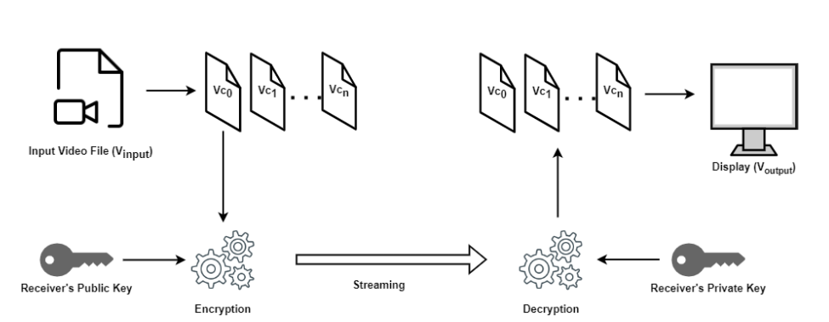
7.2.1. Video communication using public key cryptography
Figure 1: Implemenation of video chunking for securied communication

Slide 16
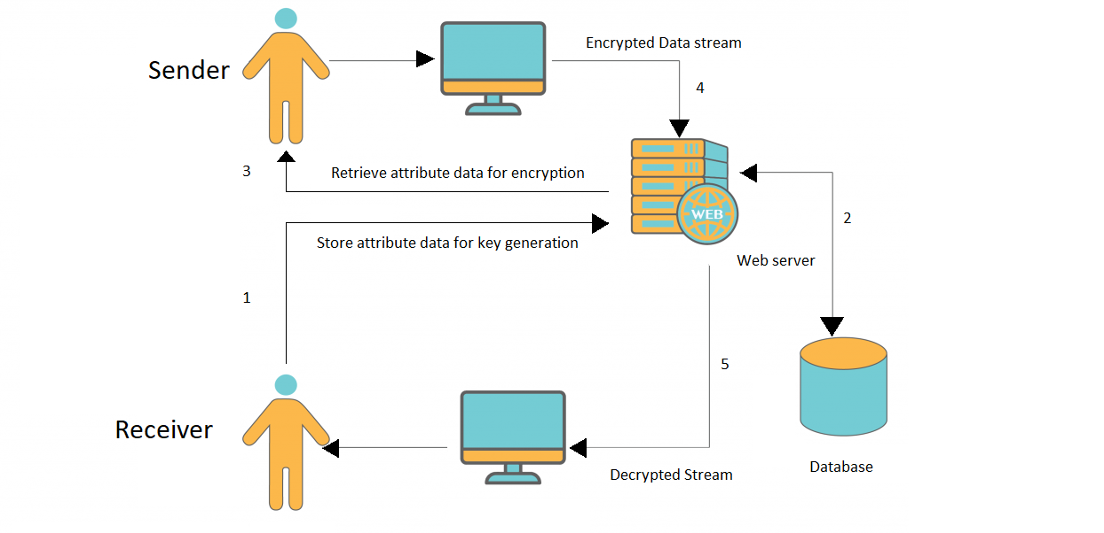
9. System Architecture
- L1
Figure 2: System architecture for proposed system at Level 1

Slide 17
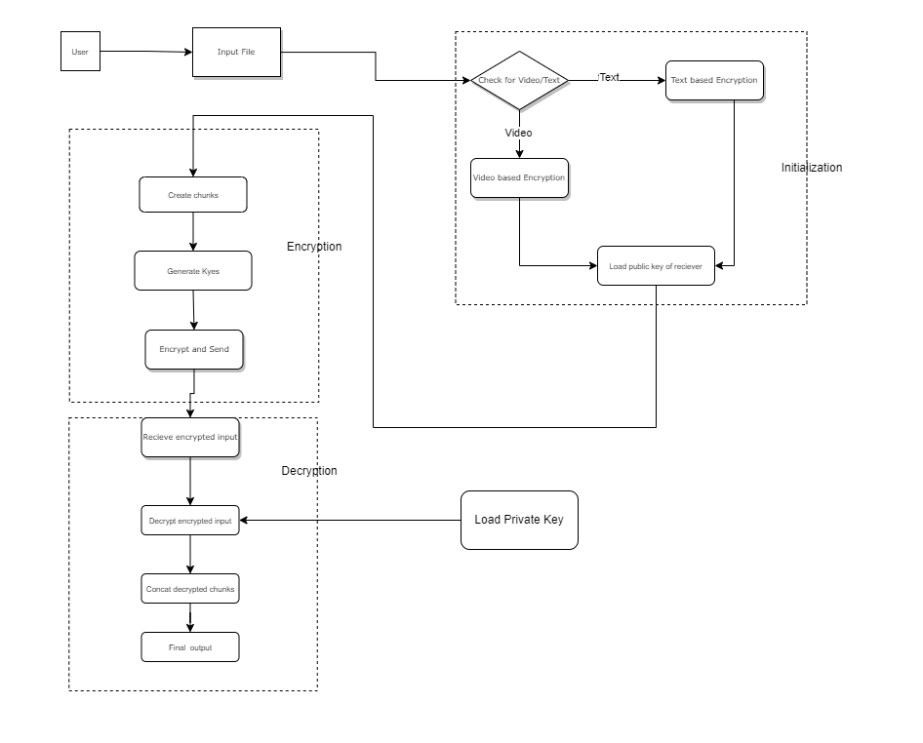
9. System Architecture
- L2
Figure 3: System architecture for proposed system at Level 2

Slide 18
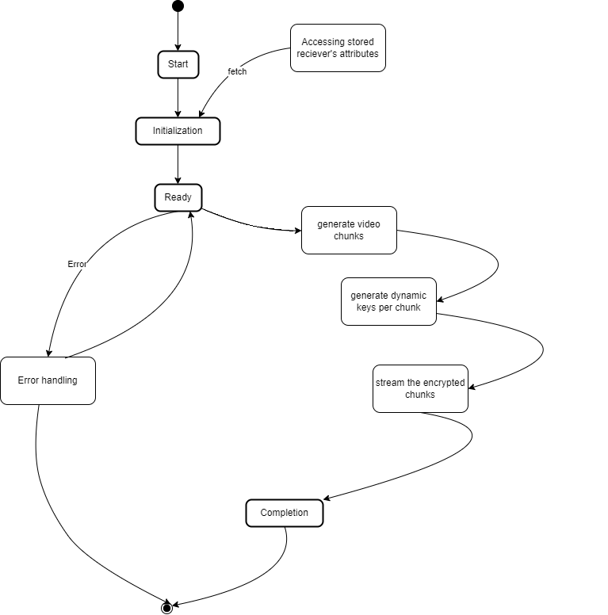
9. System Architecture
- State Diagram
Figure 4: State of system during encryption

Slide 19
10. Performance Evaluation
Delay for Splitting File to Chunks
Time to Generate the Keys
Time to Encrypt the Chunks of Video
Time to Encrypt the Complete Video File
Number of Keys Generated
End-to-End Decryption Delay
Key Strength (Diffusion)
Throughput (for Encrypted Data)
Scalability (Effect of Increasing the Key Size)
Algorithm Agility (Ability to Use or Switch Algorithms for Varying Video Size)

Slide 20
11. Conclusion
Adaptability: Exhibits a high degree of adaptability and future-proofing by incorporating dynamic key derivation mechanism
User-Focused Security: Real-time key generation based on unique identifiers provides dynamic protection for file chunks.

Slide 21
Reference
Youcef Fouzar and et. al. “A Novel Hybrid MultiKey Cryptography Technique for Video Communication” 30th January 2023, IEEE Access
DOI: 10.1109/ACCESS.2023.3242616

Slide 22


